Slide 1



Bangalore Luxury Housing
Sales & Insights
Presenter
Geetha Palanisamy
MDTM46B

Slide 2

PROJECT FLODER STRUCTURE
PROJECT OVERVIEW
PROJECT GOAL
To analyze luxury housing sales across Bangalore’s micro markets by cleaning raw data, storing it in a structured database and building an interactive dashboard for better insights.
TOOLS USED
Python | MySQL | Power BI
Data cleaning | Structured storage of clean data | Creating interactive dashboards
Validation | Querying for validation and aggregation | Visualizing trends and insights
Luxury Housing Sales
Data
Raw data
Cleaned data
Src
Load data
Clean data
Load to db
.env

Slide 3
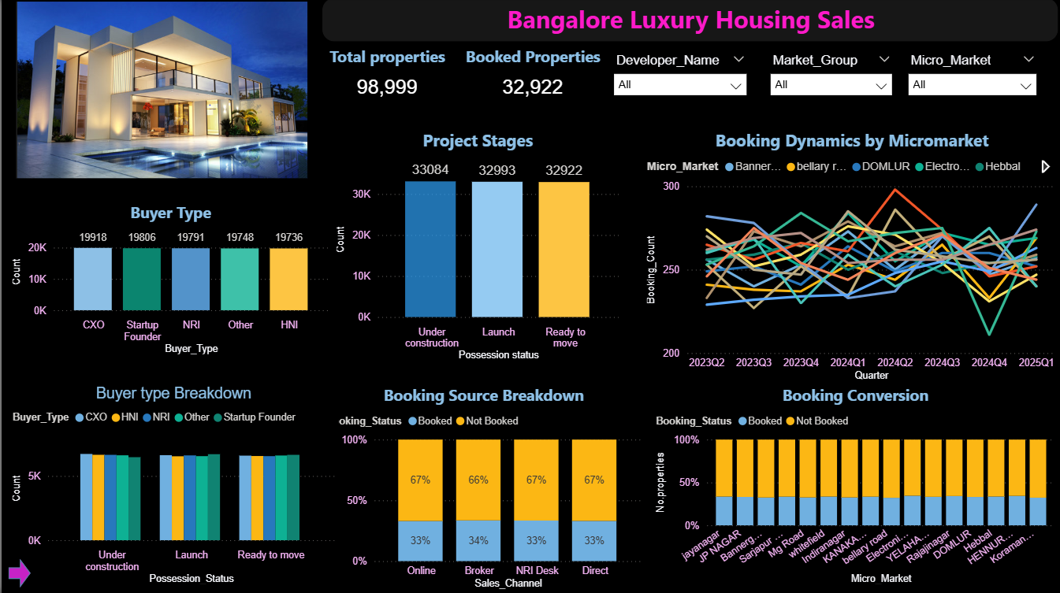
DASHBOARD OVERVIEW

Slide 4
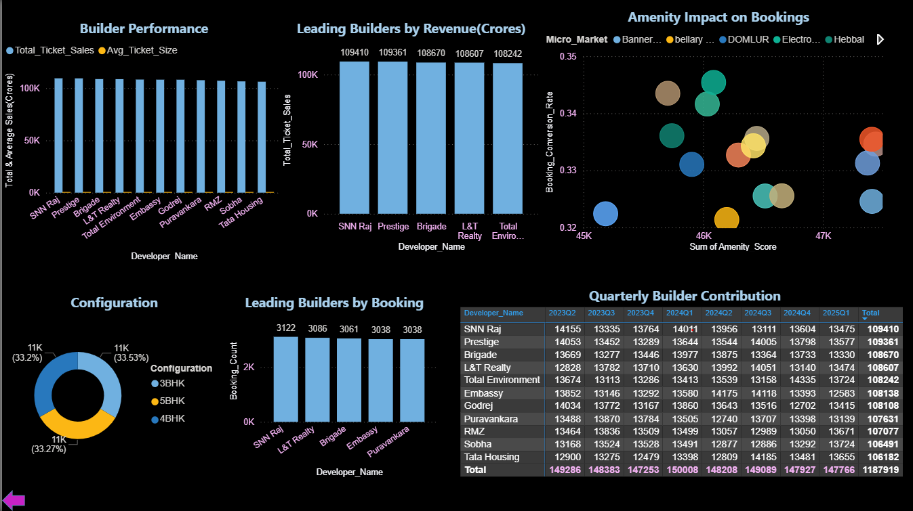
DASHBOARD OVERVIEW

Slide 5
Raw Data Cleaning
Changes made
Configuration
  Convert 3bhk, 3-BHK, 3 BHK → 3BHK→3
Ticket_Price_Cr
  '₹1.5 Cr', '85 Lakh', '1,20,00,000' → float in Crore
Convert NRI_buyer into Boolean
For categorical missing values → Mode
For numeric missing values → Median
For other datatypes→ “Unknown”
Any row where Bedrooms is less than 1 or greater than 6 is removed as an outlier.
Ticket_Price_Cr
  Values below 0.2 Cr or above 30 Cr are considered outliers and are removed.
Purchase_Quarter
  31-03-25 ,30-06-24 ,31-12-23 ,31-03-24…these are indicating last date of every quarter, so it has been changed as year and quarter columns like year 2025, qaurter1
Derived Columns
  Price_Per_Sqft= Ticket_Price_Cr* 1e7 / 'Unit_Size_Sqft
Booking Flag as Boolean
  'ready to move’: 1, 'under construction': 'launch’: 0
Outcome
Details | Rows | Columns
Before Cleaning | 101000 | 18
After Cleaning | 99989 | 23

Slide 6
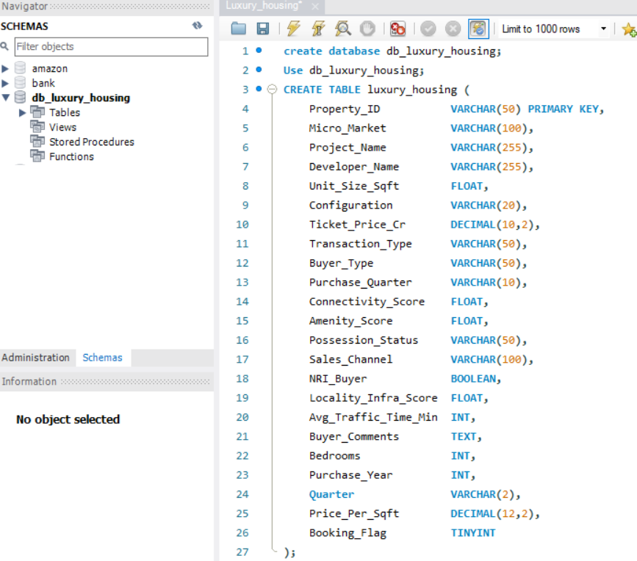

Load Data to MySQL DB
SQL Table Schema Creation
Check Schema creation
Load data to db
Connect to db→insert→convert as dataframe→Bulk insert
Check connection is created

Slide 7
Connect PowerBI to MySQL
Avg_Ticket_Size = AVERAGE(luxury_housing[Ticket_Price_Cr])
Booking_Conversion_Rate =
DIVIDE( SUM(luxury_housing[Booking_Flag]),
COUNTROWS(luxury_housing), 0 )
Project_Count = DISTINCTCOUNT(luxury_housing[Project_Name])
Booking_Status = IF(luxury_housing[Booking_Flag] = 1, "Booked", "Not Booked”
Market_Group =
  SWITCH(
  TRUE(),
  [Micro_Market] IN {"Electronic City", "jayanagar", "Sarjapur Road", "Rajajinagar", "HENNUR ROAD"}, "Top5",
  [Micro_Market] IN {"JP NAGAR", "whitefield", "KANAKAPURA ROAD", "Hebbal", "Bannerghatta Road"}, "Mid5",
  [Micro_Market] IN {"YELAHANKA", "DOMLUR", "Mg Road", "Indiranagar", "bellary road", "Koramangala"}, "Least6")
Supporting measures in DAX
YearQuarter =
  VAR yr = luxury_housing[Purchase_Year]
  VAR qtxt = FORMAT(luxury_housing[Quarter], "")
  VAR qnum = VALUE( SUBSTITUTE( qtxt, "Q", "" ) )
  RETURN
  IF( OR( ISBLANK(yr), ISBLANK(qnum) ), BLANK(), FORMAT(yr, "0000") & "Q" & qnum )
YearQuarterSort =
  VAR yr = VALUE( luxury_housing[Purchase_Year] )
  VAR qtxt = FORMAT( luxury_housing[Quarter], "" )
  VAR qnum = VALUE( SUBSTITUTE( qtxt, "Q", "" ) )
  RETURN
  IF( OR( ISBLANK(yr), ISBLANK(qnum) ), BLANK(), yr * 10 + qnum )
Booking_Count = SUM(luxury_housing[Booking_Flag])
Total_Ticket_Sales = SUM(luxury_housing[Ticket_Price_Cr])

Slide 8
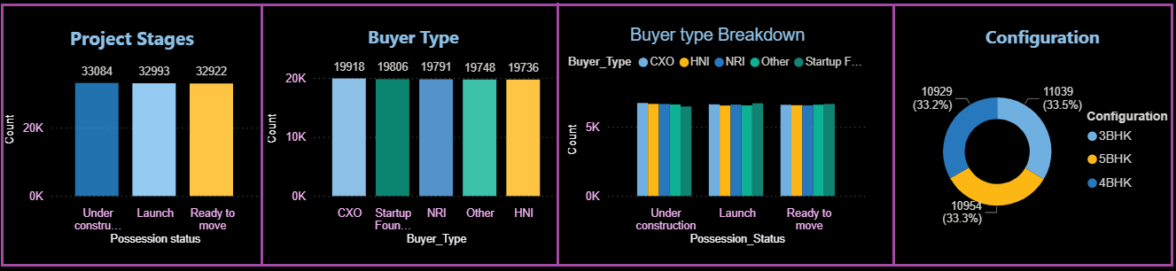
Buyer Insights
The total properties accounted for analyzing the luxury housing sales is 98,999. Out of which 32,922 are considered as booked as they are ready to move properties
The distribution of properties across various stages like under construction(33084), Launch(32993) and ready to move(32922) phase is almost equal. So buyers have option irrespective of whether they are looking for immediate possession or investing in future period. This balance also helps developers to avoid oversupply.
Luxury Housing Buyers are diverse and evenly distributed not dominated by one segment, so campaigns should be specific like life style oriented for NRI, finance friendly for start ups
Each buyer segment is spread across all project stages, so we can see that investments are not only occurs in ready to move units but also under construction and newly launched projects
Buyers have an equal preference for different configurations, so developers should categorize pricing, amenities and layouts which meet a from broad spectrum of needs from nuclear families to larger groups

Slide 9
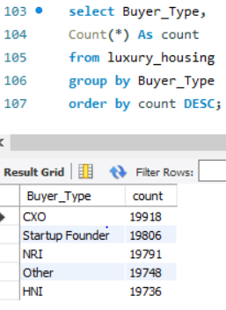
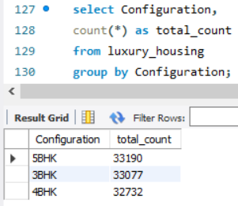
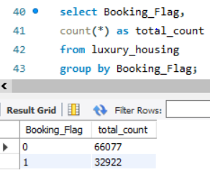
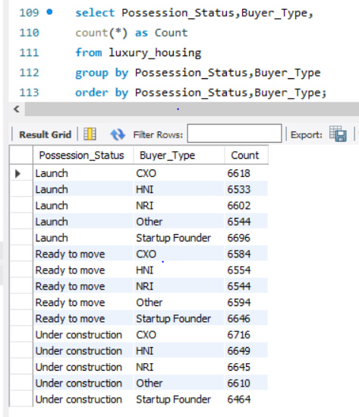
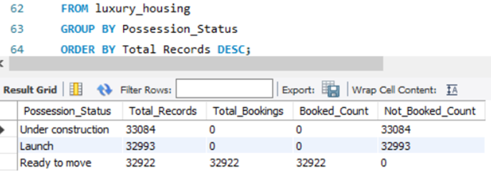
Buyer insights – Supporting SQL Queries
BUYER TYPE
CONIFIGURATION
BOOKING FLAG
POSSESSION STATUS
POSSESSION STATUS

Slide 10
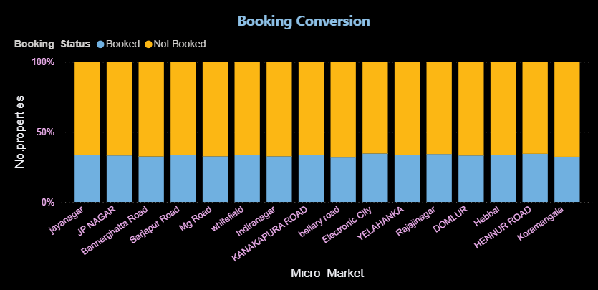
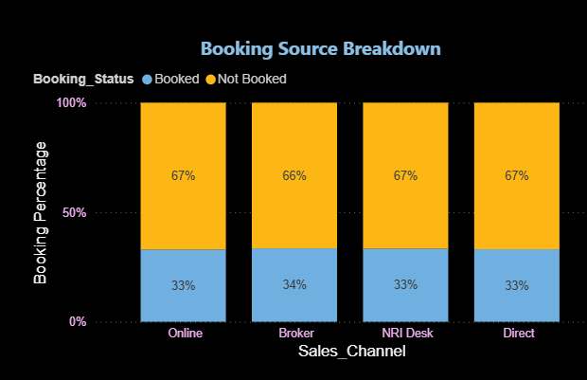
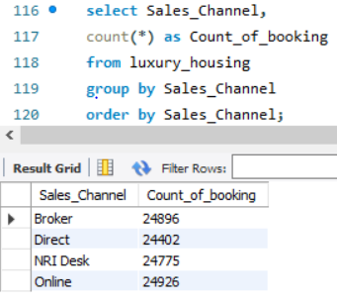
Property Booking Insights
Most micro markets have high proportion of not booked properties (under Construction and launch) indicating that unsold large portion of available units.
Booking percentages are fairly similar ranging between 32-34%, Not booked properties percentage varies from 65-68%, This indicates demand of properties is not highly differentiated across regions
Despite uniformity, Yelahanka, Hennur road, Electronic city have higher end of 34% in booking ratio
All sales channels are fairly contributed for property booking, so there is channel specific issue in property selling
SALES CHANNEL

Slide 11
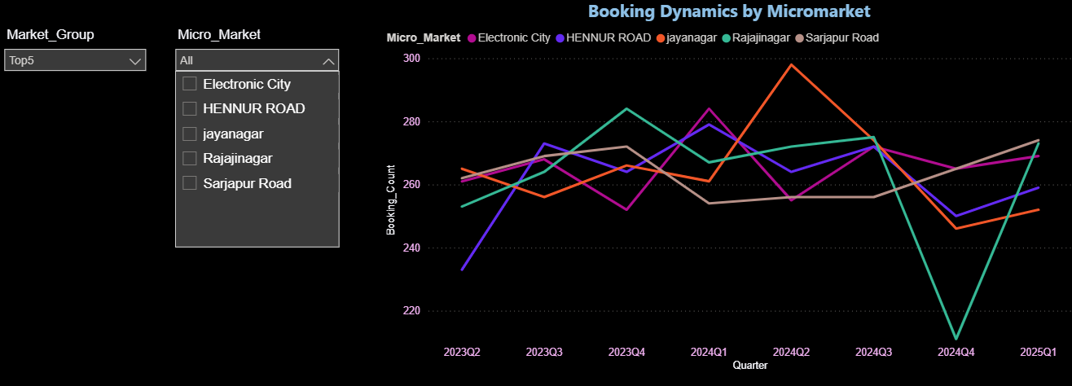
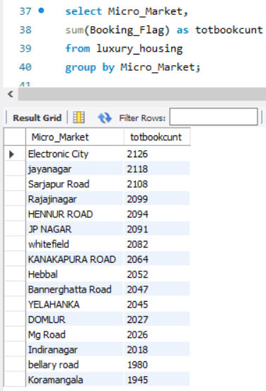
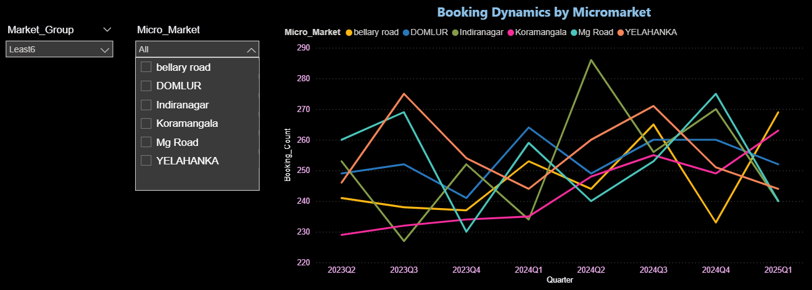
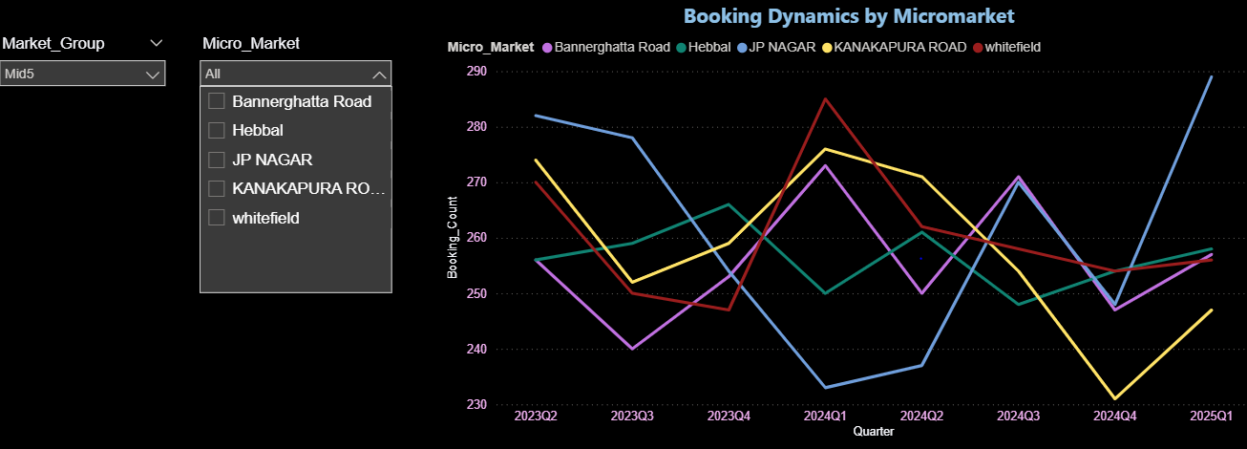
Booking Dynamics
MICRO MARKET
Analytical
These 3 charts show booking counts of property over several quarters
First slicer categorize the micro markets as micro group as top5, Mid5, least 6.
Second slicer can be used to select the particular micro markets out of 16
Seasonal Trends and Sales Strategy
Booking counts are subjected to dips mostly in Q2 and Q4 may be due to seasonal holidays and year end financial planning →Need: Targeted campaigns and flexible offers
Actionable recommendations:
  Top markets should focus on scaling of projects and enhancing customer experience
  Weaker markets should investigate their reasons of poor performance compared to competitors like accessibility, pricing, offers

Slide 12
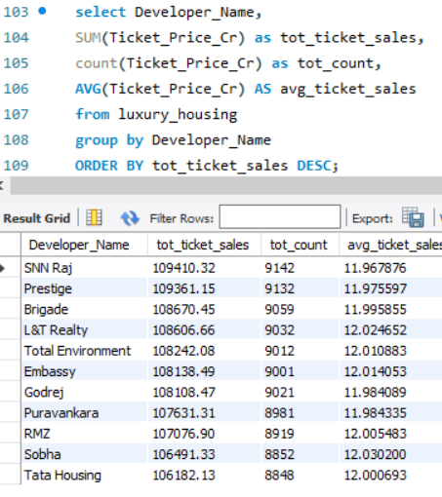
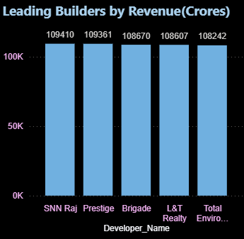
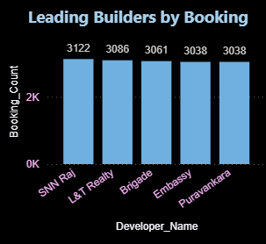
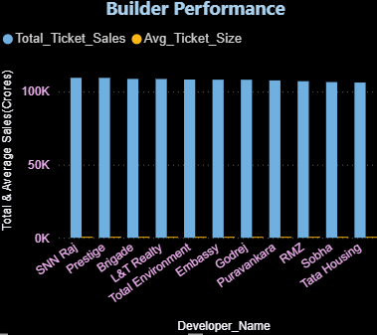
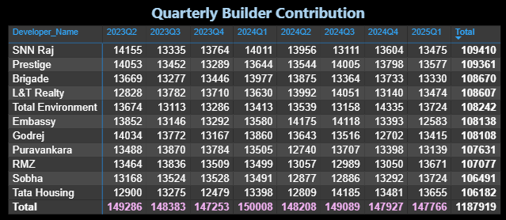
Builder Performance
Key Players and Market Performance
SN Raj is the undisputed leader in both metrics(count & Revenue)
SNN RAJ, L&T, Brigade all are showing balanced n strong market presence
Prestige is notable layer ranking second in total ticket sales, though its booking volume might be lower than some competitors.
Quarterly rend showcases a healthy and growing market for luxury housing with increased demand over time

Slide 13
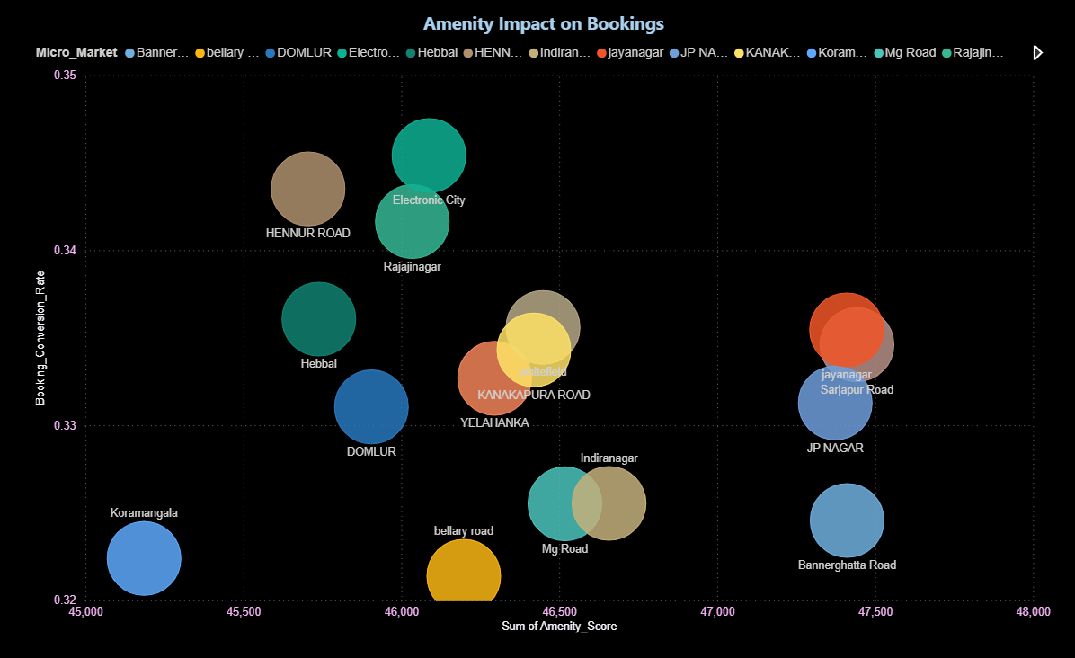
Amenity Score Impact on Bookings
Based on the visualization, we can say that amenity score does not directly or consistently leading to higher booking conversion rate.
For example, Jayanagar, JP Nagar, but their booking conversion rates are relatively low.
Markets like Koramangala have low amenity score(45000) but BCR is not significantly different from some of high amenity markets
Electronics city, Rajajinagar, Hebbal have moderate amenity scores, show highest BCR(0.34-0.35)

